Slide 1
IOT BASED LATTERBOX
TASK 4
BINDU
GROUP 10

Slide 2
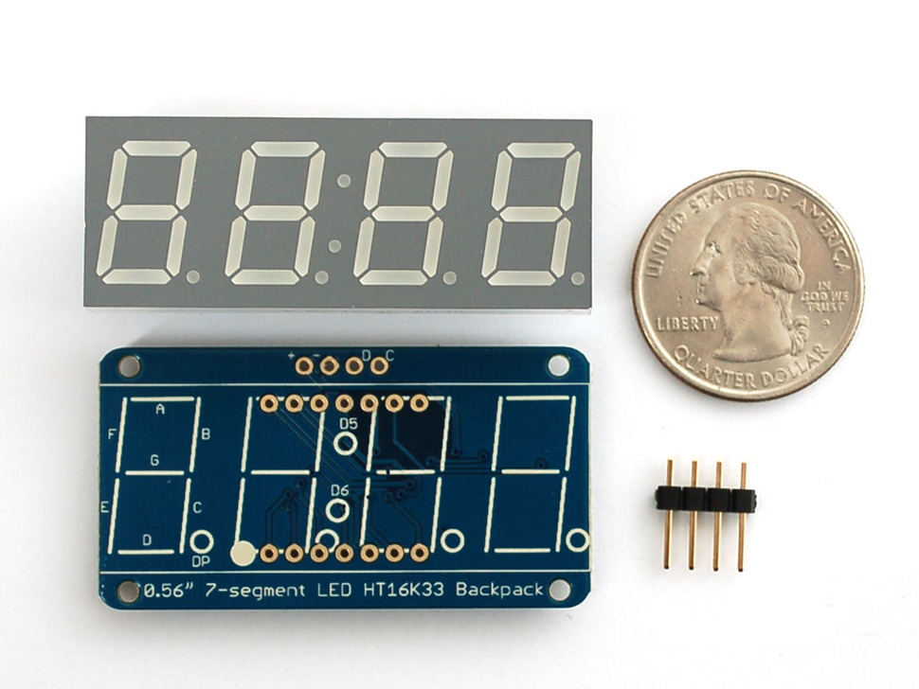
INTERFACING 7 SEGMENT DISPLAY WITH BBB
This Adafruit 7 segment display comes with i2c backpack which limits the number of wires will we used in interfacing it.

Slide 3
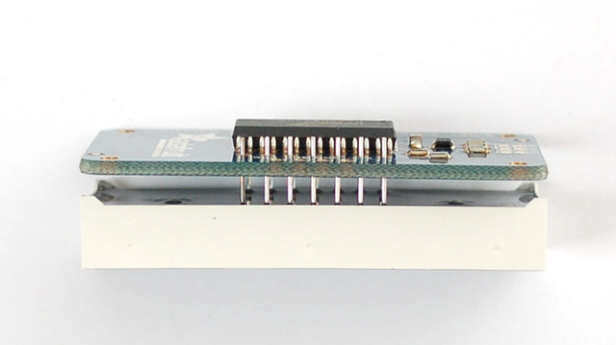
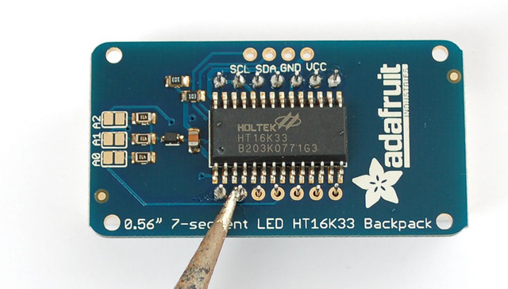
SOLDERING OF DISPLAY WITH BACKPACK
Before using this display it is required to be soldered with backpack otherwise it will not turn on or will fluctuate continuously.

Slide 4
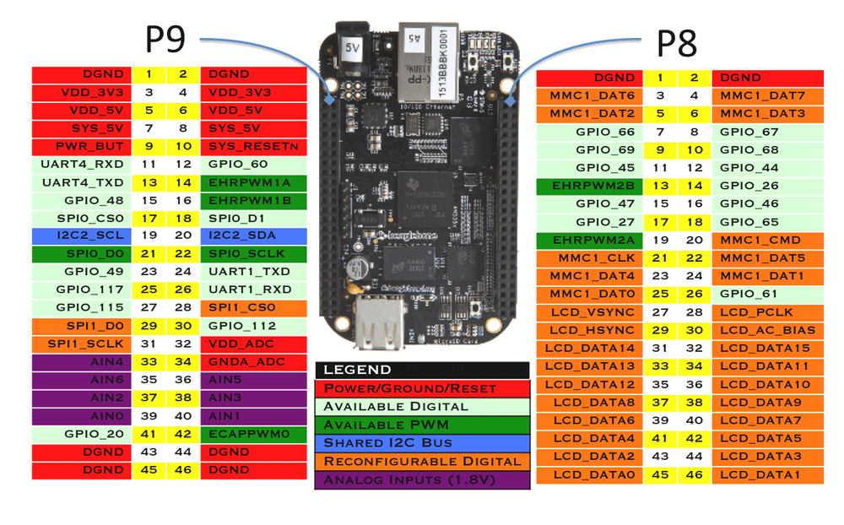
PINOUT OF BBB

Slide 5
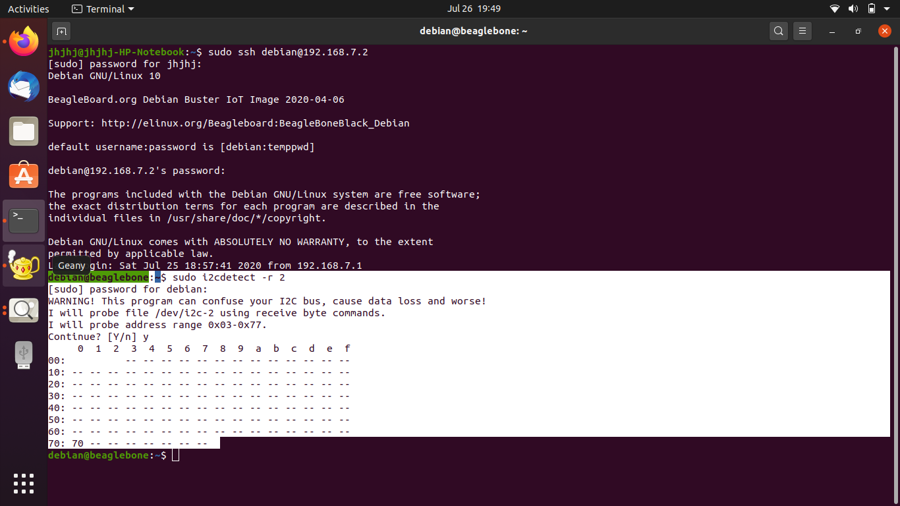
INPUT FROM DISPLAY

Slide 6
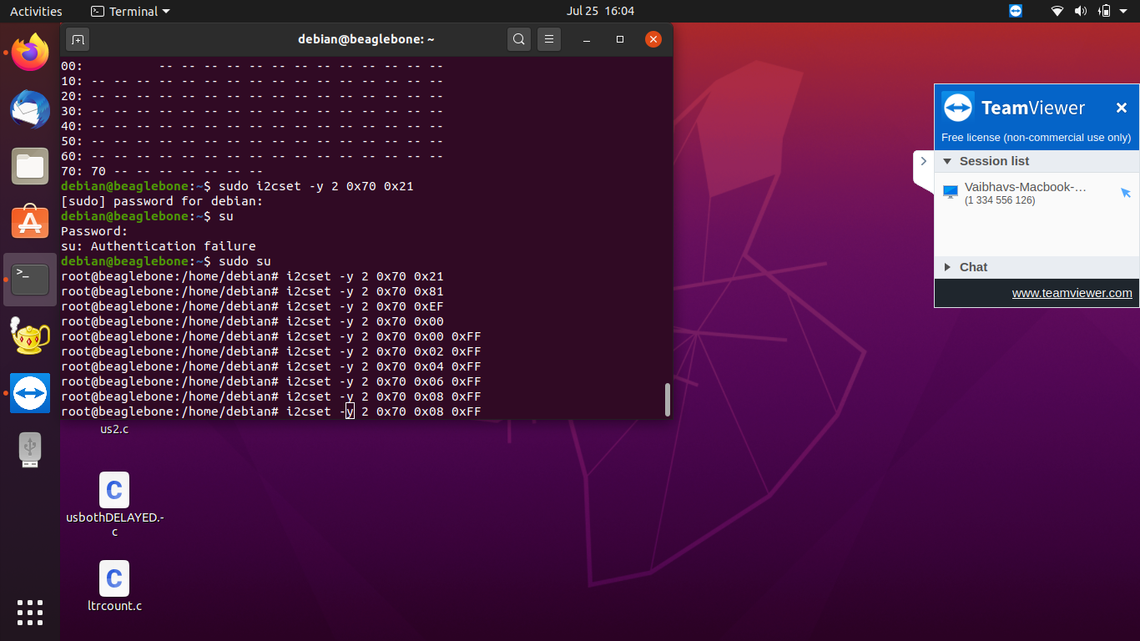
COMMANDS TO WRITE & INITIATE DISPLAY

Slide 7
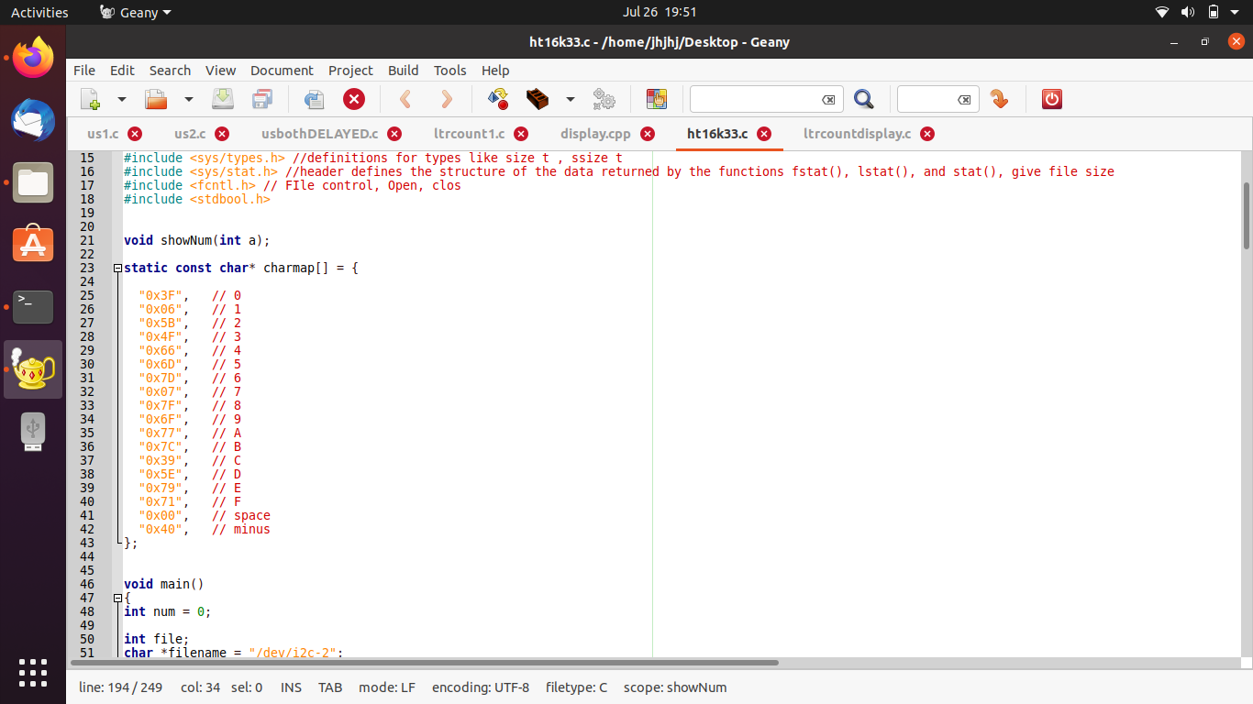
HT16K33.c CODE

Slide 8
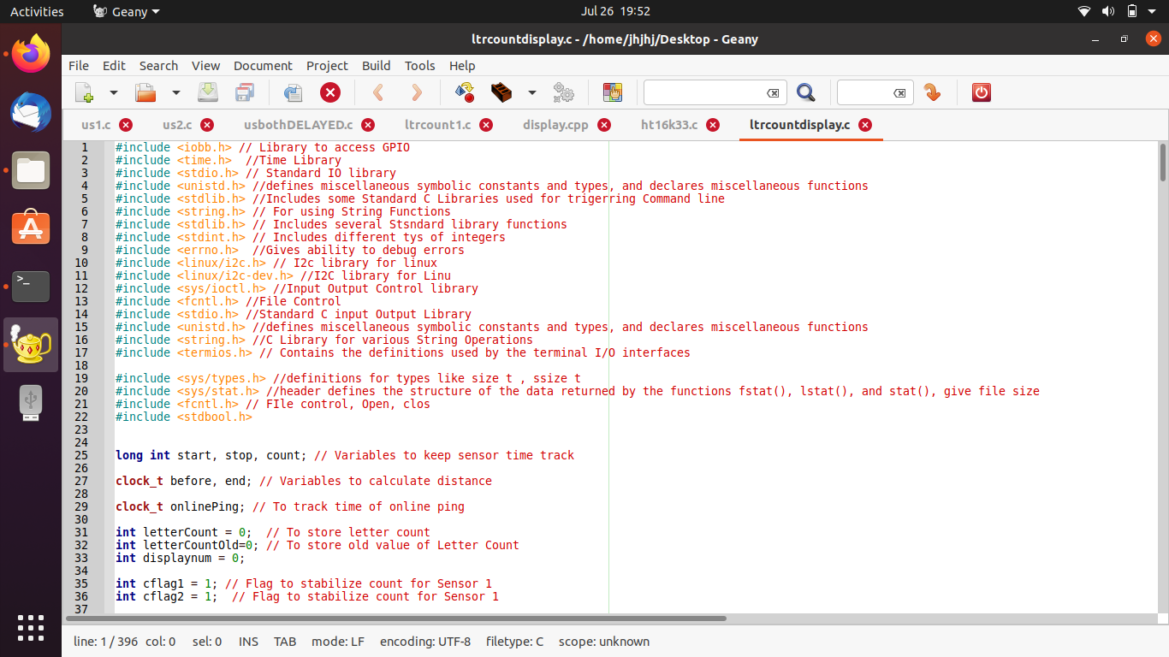
LETTER COUNTING DISPLAY CODE

Slide 9
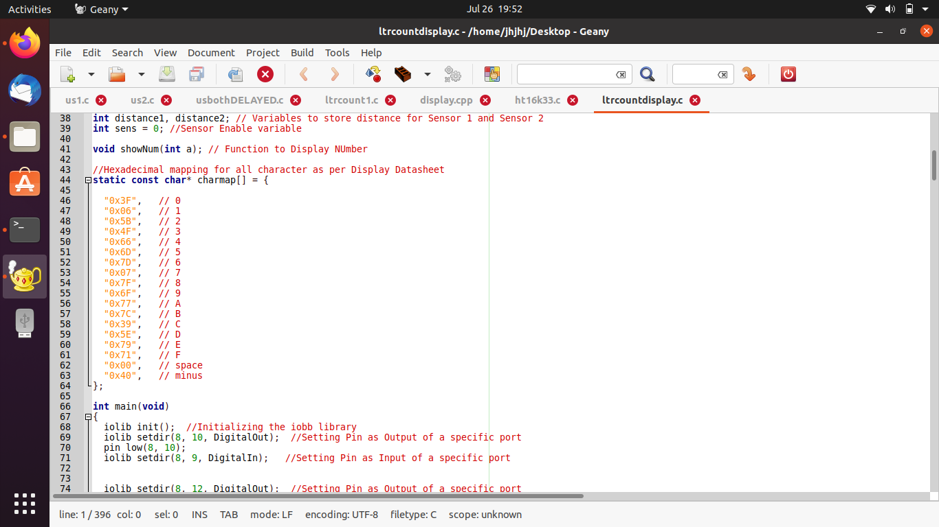
Cont..

Slide 10
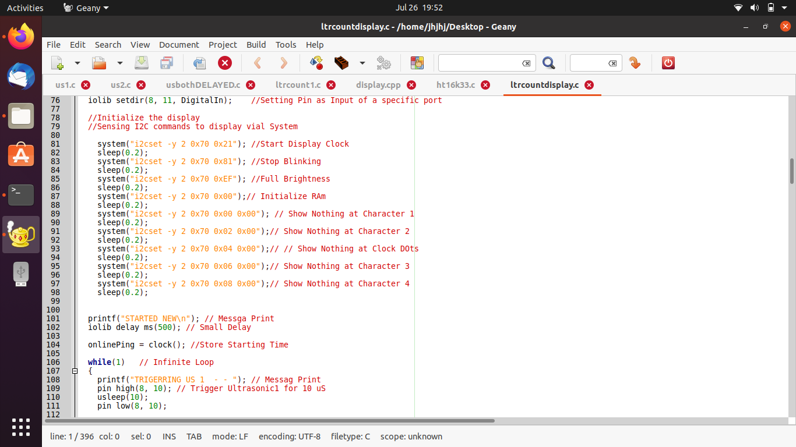
Cont..

Slide 11
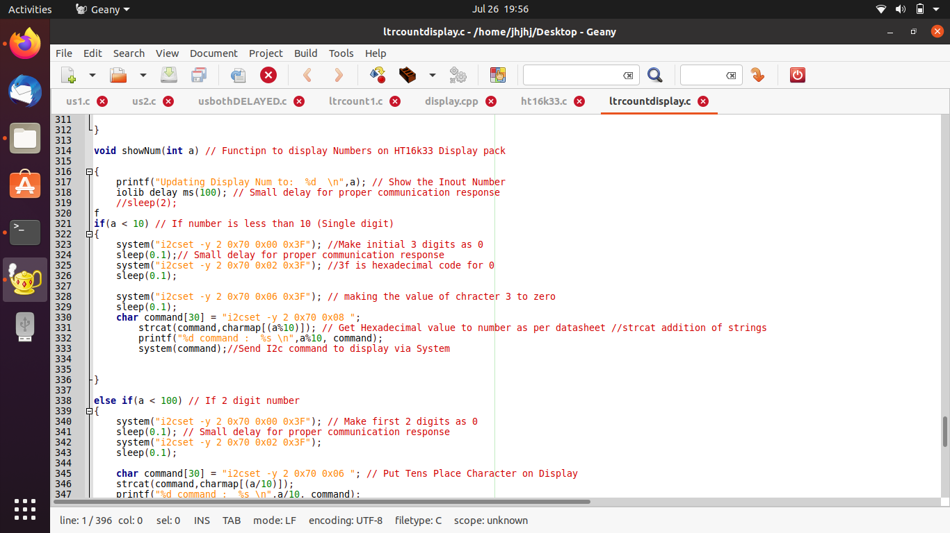
Cont..

Slide 12
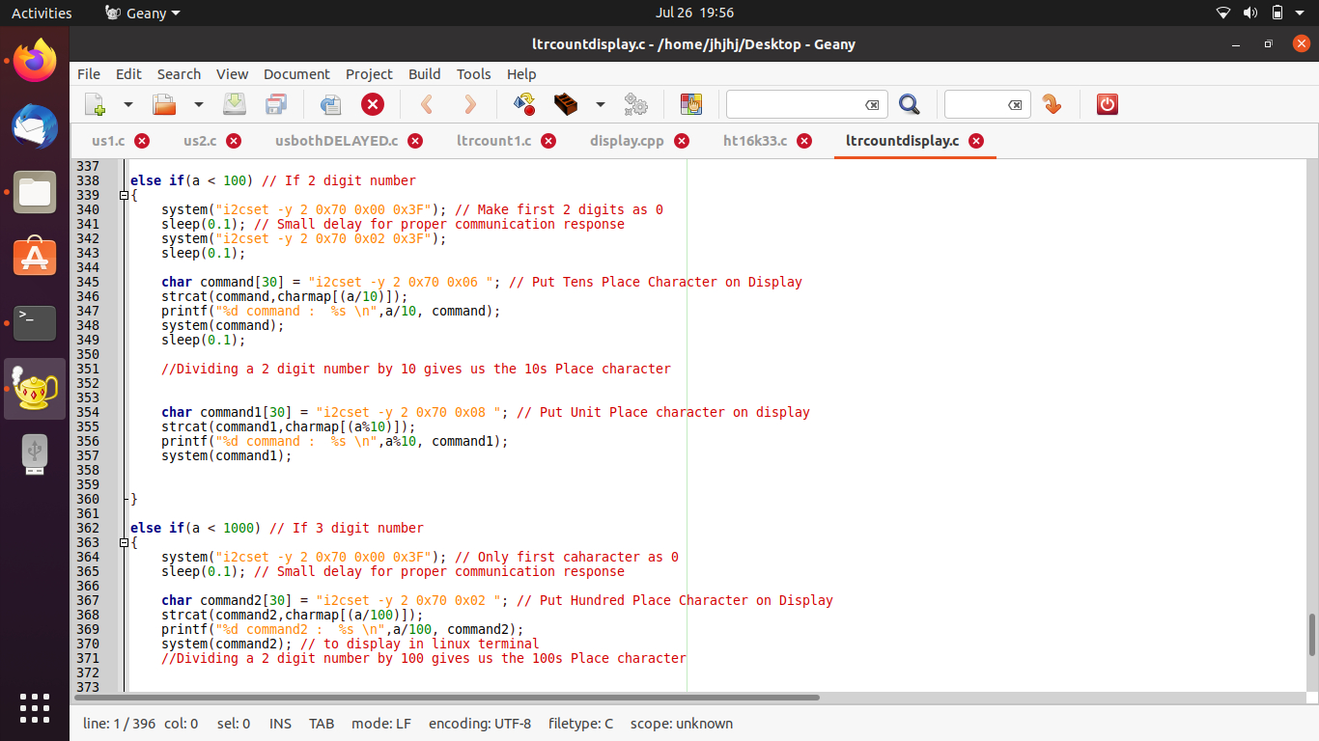
Cont..

Slide 13
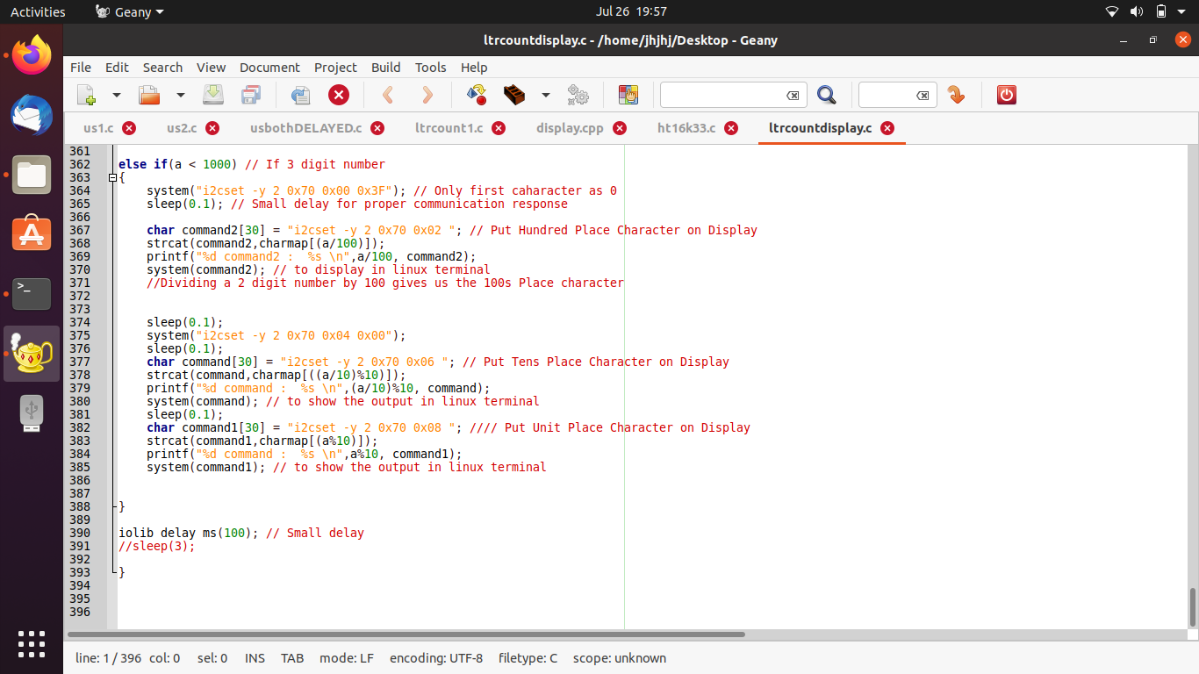
Cont…

Slide 14
REFERENCES
Adafruit LED Backpacks. (n.d.). Retrieved from Adafruit.ca: https://learn.adafruit.com/adafruit-led-backpack/0-dot-56-seven-segment-backpack-assembly
Adafruit.ca. (n.d.). Retrieved from LED Backpack Displays on Raspberry Pi and BeagleBone: https://cdn-learn.adafruit.com/downloads/pdf/led-backpack-displays-on-raspberry-pi-and-beaglebone-black.pdf
ht16k33. (n.d.). Retrieved from github.com: https://github.com/topics/ht16k33
Interfacing BeagleBone Black with Adafruit 7-segment LED display. (n.d.). Retrieved from www.element14.com/: https://www.element14.com/community/community/designcenter/single-board-computers/next-genbeaglebone/blog/2013/11/04/interfacing-beaglebone-black-with-adafruit-7-segment-led-display
Raspberry Pi and an 8x8 LED Matrix, using C. (n.d.). Retrieved from ozzmaker.com: https://ozzmaker.com/raspberry-pi-and-an-8x8-led-matrix-using-c/

